Slide 1

CAP
Cryptographic Analysis Program
General Help Presentation
Press Enter or click on your mouse button to continue

Slide 2
What is CAP?
CAP is a general purpose tool for the study of classical (and some contemporary) ciphers
CAP is really three related programs in one
  a program that will encrypt and decrypt text using your choice of several algorithms
  a set of tools for breaking unknown ciphers
  a game which will generate random ciphers and challenge you to break them
This presentation will introduce you to the general features of CAP

Slide 3

Contents
Click on the items below to jump to help on the specific topic
  Or just continue to advance through this presentation

Slide 4
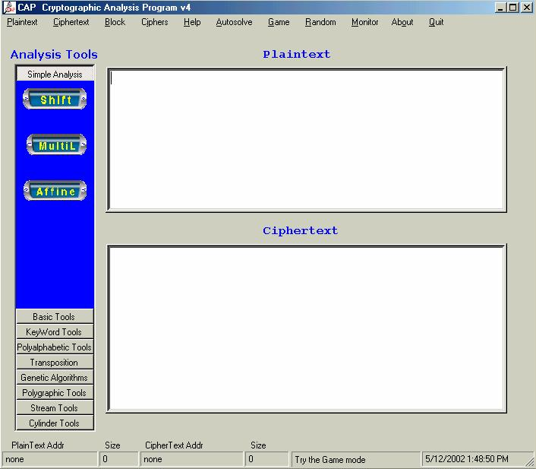


Main Window
When you first open CAP this is the main window:
Enter
Plaintext
Enter
Ciphertext

